Slide 1

Data Transformation I

Slide 2
Introduction
Read Chapter 3
Goal: Their Data Your Data
Covers:
Data Subsetting
Data Ordering
Variable Selecting
Variable Creating
Help: dplyr Package in R

Slide 3
NYC Flights Meta Data
Requirements:
All 2013 Flights from NYC
- US Bureau of Trans. Statistics
To View all Data, Use
For more information,
> install.packages(nycflights13)
> library(nycflights13)
> View(flights)
> ?flights

Slide 4
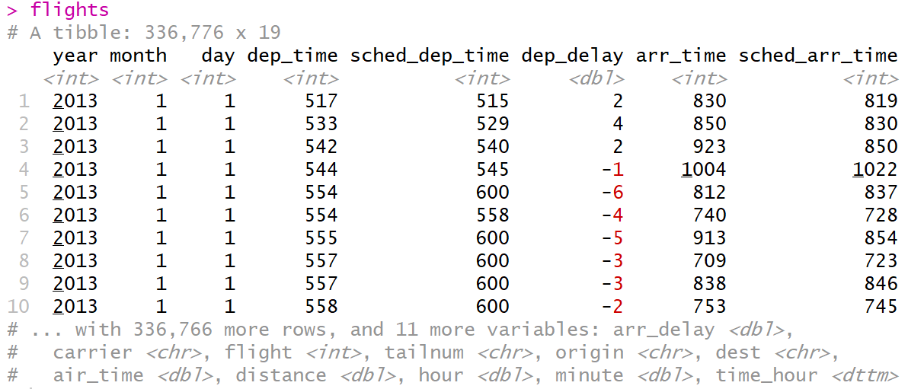
NYC Flights Meta Data
Preview Data:
Four Different Types of Variables
int = integer
dbl = double
chr = character
dttm = date and times
Other Types of Variables
lgl = logical (TRUE or FALSE)
fctr = factor
date = dates
> flights

Slide 5
Basics of dplyr
5 Key Functions
filter() = Chooses Observations Based on Values
arrange() = Sorts Observations
select() = Chooses Variables
mutate() = Creates New Variables
summarize() = Generates Statistics From Data

Slide 6
Basics of dplyr
Function Usage
First, Specify the Dataset
Next, Specify What to Do with the Data
Result is a New Dataset
Powerful When Used With group_by() Function

Slide 7
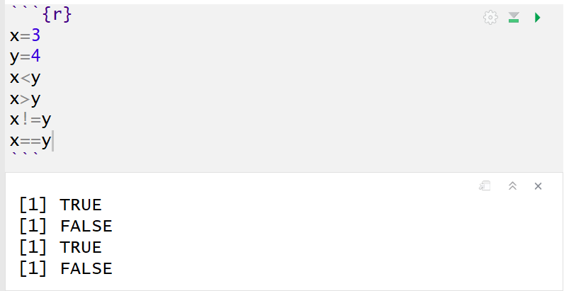
Comparisons
Important Operators
Less Than (<)
Greater Than (>)
Not Equal (!=)
Equal (==)
Returns TRUE or FALSE

Slide 8
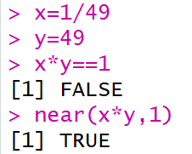
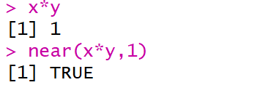
Comparisons
Numerical Precision
Problem
Solution

Slide 9
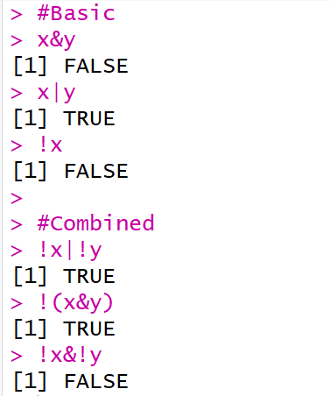
Logical Operators
Boolean Logic
And (&)
Or (|)
Not (!)
Example

Slide 10
Missing Values
Represented by NA
Enduring Questions
To Impute or Not Impute
To Ignore or Not Ignore
Handling Should Be Explained
Be Careful When Performing Operations on Missing Data

Slide 11
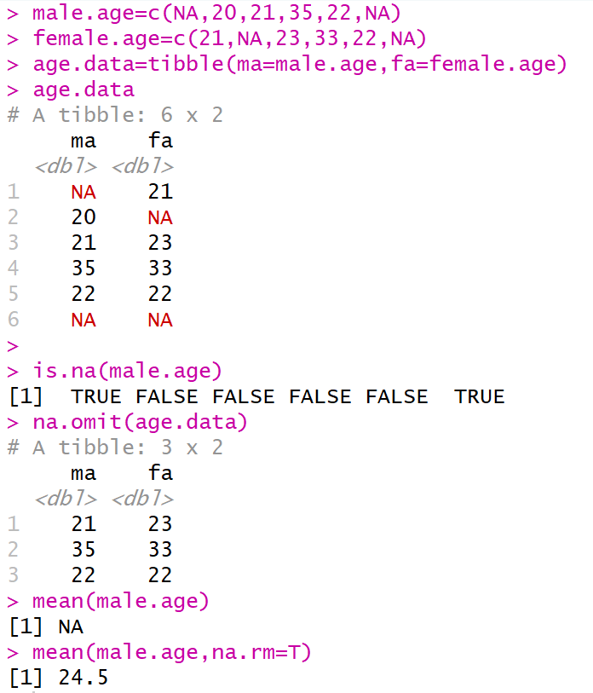
Missing Values

Slide 12
filter()
Used to Subset Observations Based on Their Values
Selects Row if TRUE
Removes Row if FALSE
Examples:
All Flights from 9/13/2018 Out of LaGuardia Airport
All Dec. or Nov. Flights
> filter(flights,month==9,day==13,origin ==“LGA”)
> filter(flights,month==11|month==12)
> filter(flights,month %in% c(11,12))

Slide 13
filter()
Examples:
Don’t Want Flights with Unusual Delays (> 120 min.)
Want Flights with No Delays
> filter(flights, !(arr_delay>120 | dep_delay>120) )
> filter(flights, arr_delay <= 120, dep_delay <= 120)
> filter(flights, dep_delay==0, arr_delay==0)
> filter(flights, dep_delay==0 & arr_delay==0)

Slide 14
filter()
Examples:
Want Flights Missing Air Time
Do not Want Flights Missing Air Time
Remove All Cases with Missing Values
> filter(flights, is.na(air_time) )
> filter(flights, !is.na(air_time) )
> na.omit(flights)

Slide 15
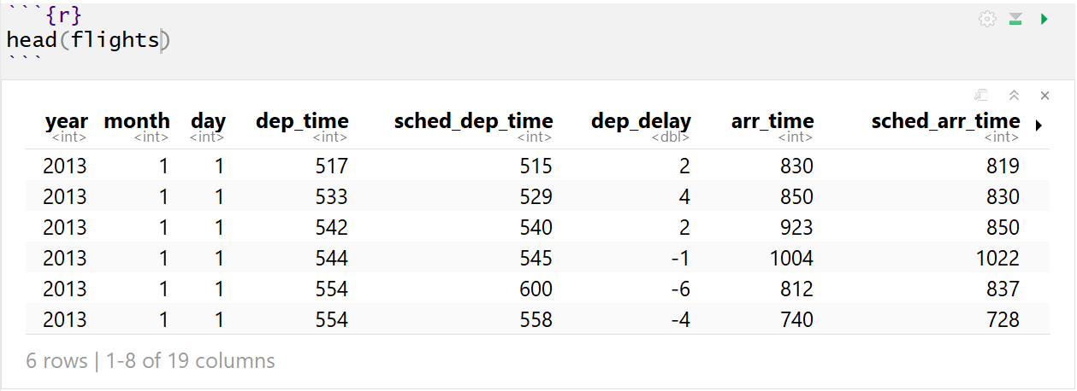
arrange()
Used to Sort Observations
Raw Flight Data
Sorted by Day, Month, Year (Time)

Slide 16
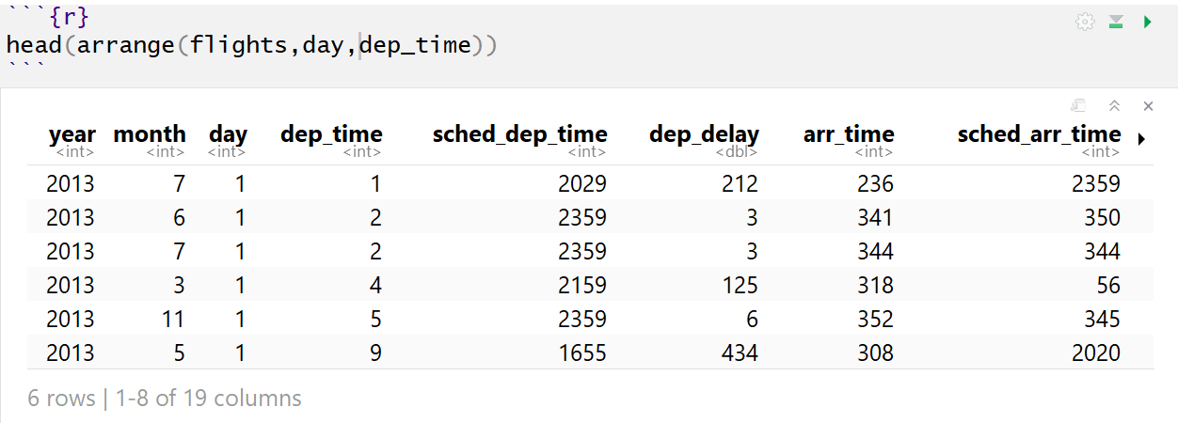
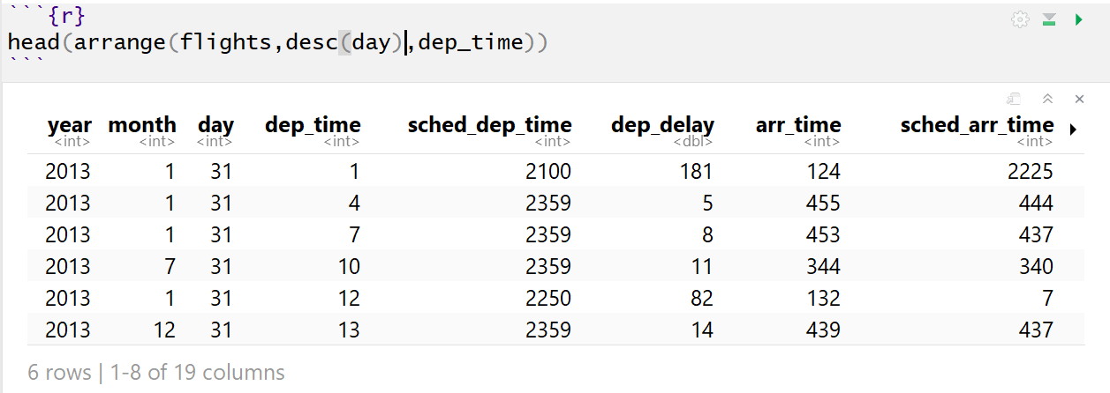
arrange()
Sorting Experiment

Slide 17
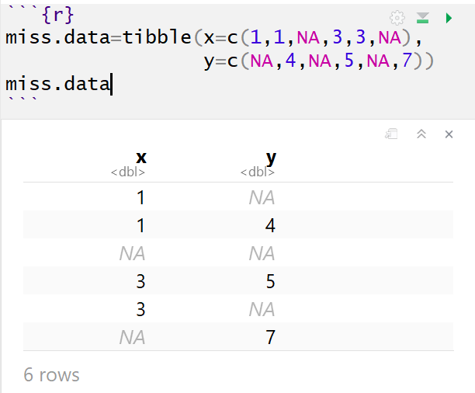
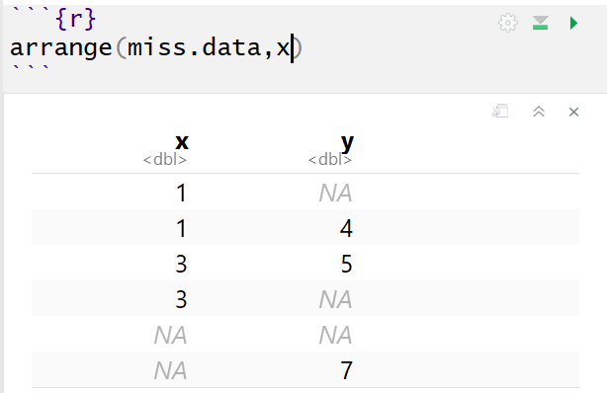
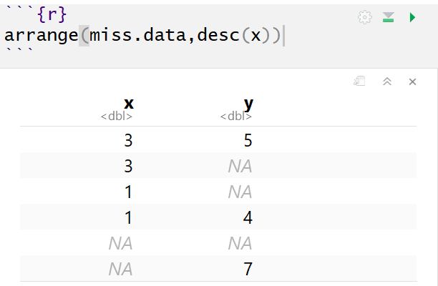
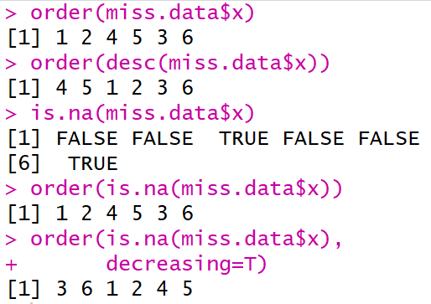
arrange()
Handling NA

Slide 18
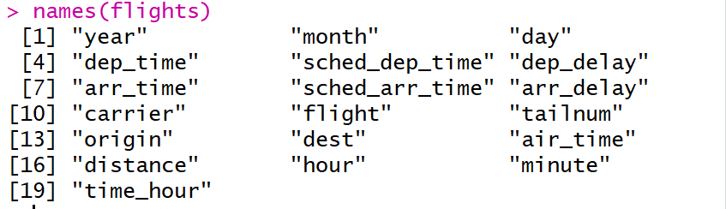
select()
Used to Select Variables
Why? Not All Variables are Created Equal
Need to Know Variable Names

Slide 19

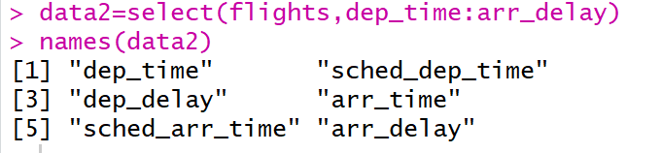
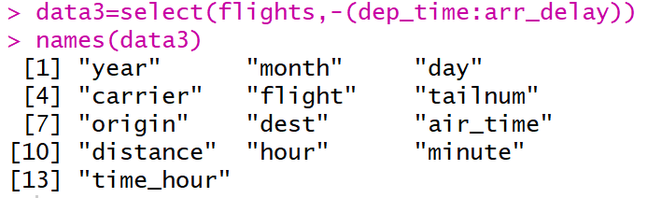
select()
Basic Examples
Select Only Year, Month, Day
Select All Variables Between dep_time to arr_delay
Deselect Year, Month, and Day

Slide 20
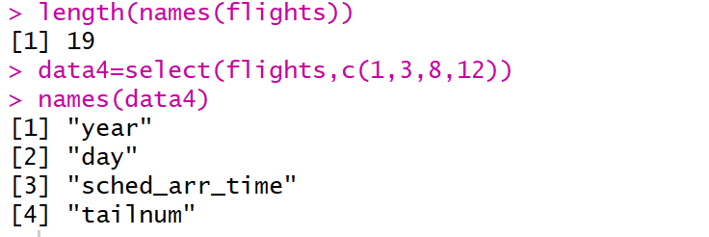
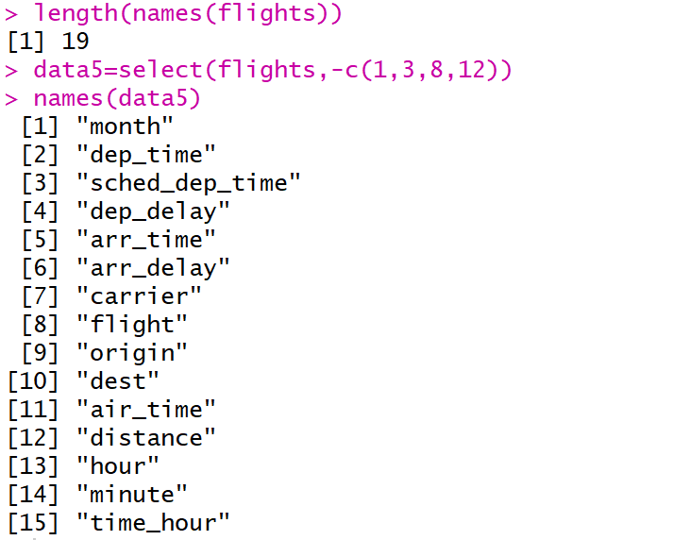
select()
Select Based on Column Index
Deselect Based on Column Index

Slide 21


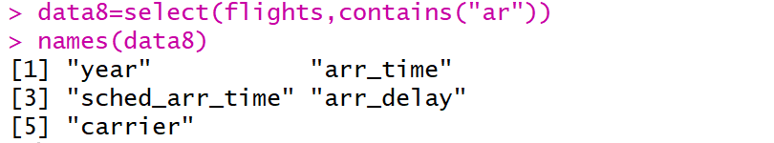
select()
Select Based on Text
starts_with(“TEXT”)
ends_with(“TEXT”)
contains(“TEXT”)
Etc. AKA Others Exist

Slide 22

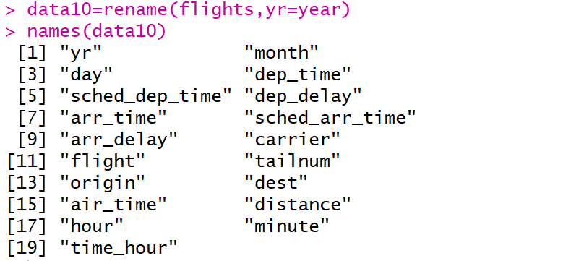
select()
Renaming Variables
Can Use select()
But Use rename()

Slide 23
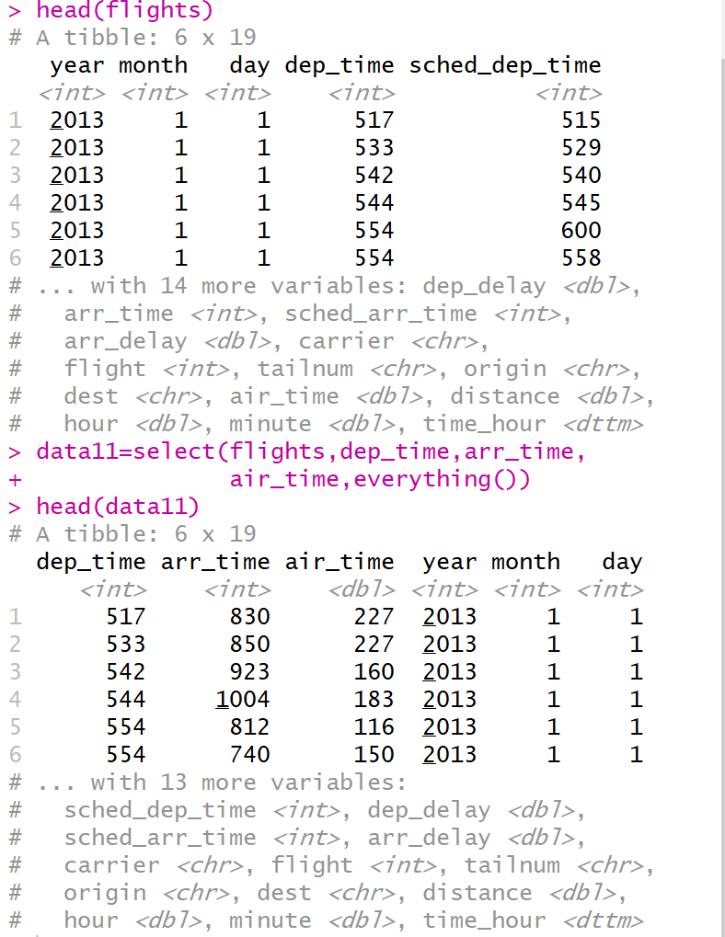
select()
Reordering Variables

Slide 24
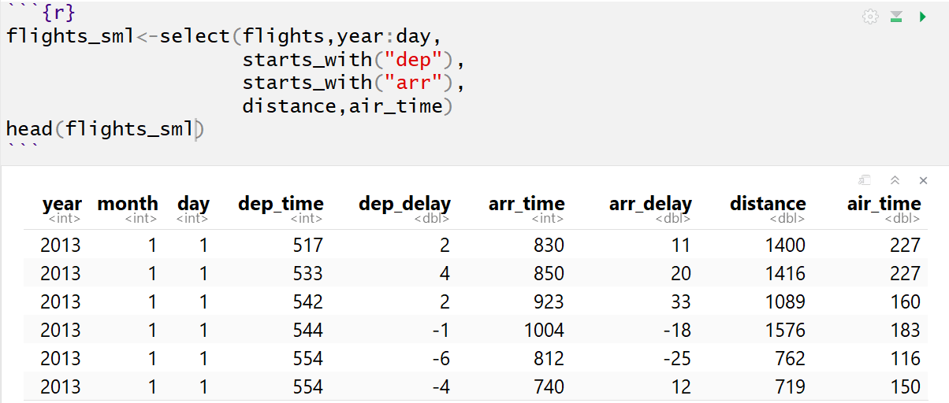
mutate()
Used to Create New Variables
Creative New Metrics
Modify Units
Transform Variables
Unique Identifiers
Numeric to Categorical
Categorical to Numeric
Reduced Dataset

Slide 25
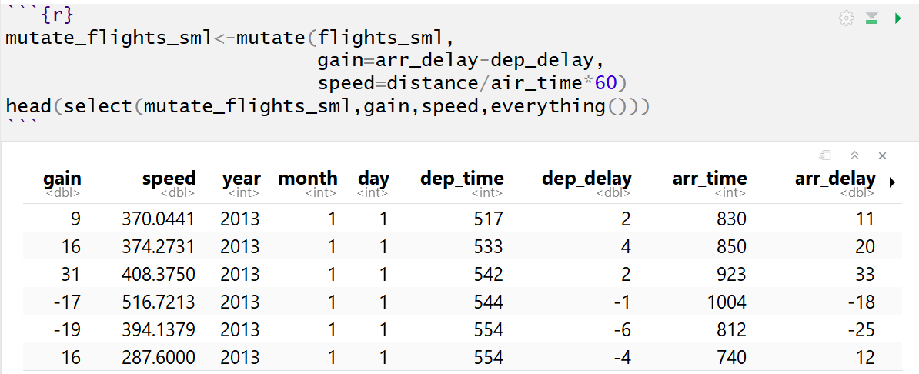
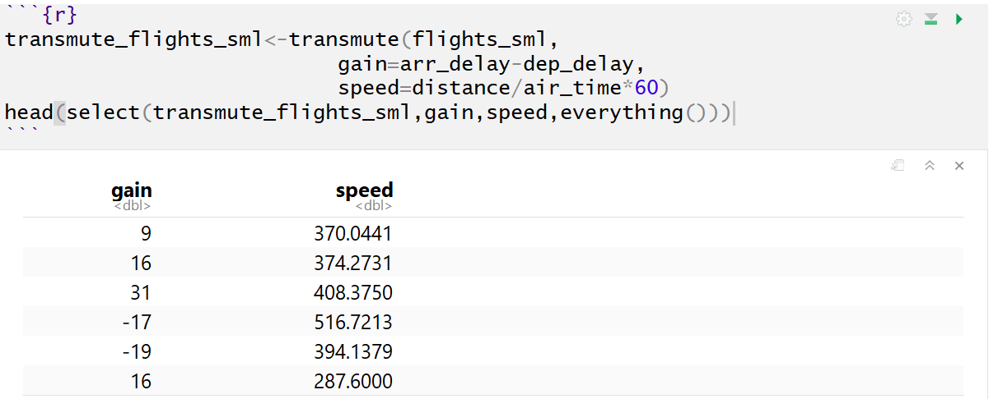
mutate()
Example of mutate()
Example of transmute()

Slide 26
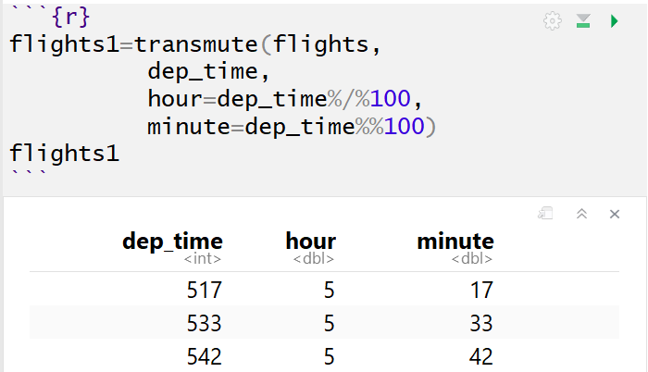
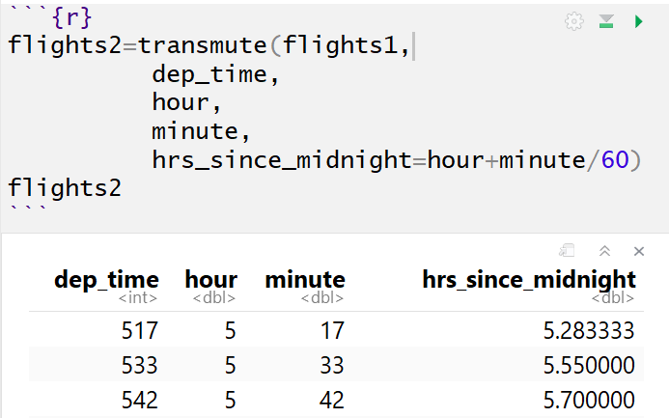

mutate()
Plethora of Examples
Basic and Modular Arithmetic
$517=100∗5+17$
$=100∗\left(517 \%/\% 100\right)+(517 \%\% 100)$

Slide 27
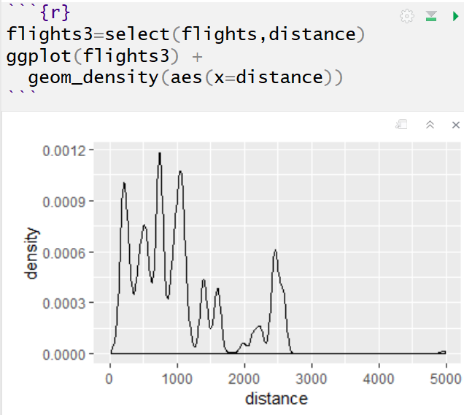
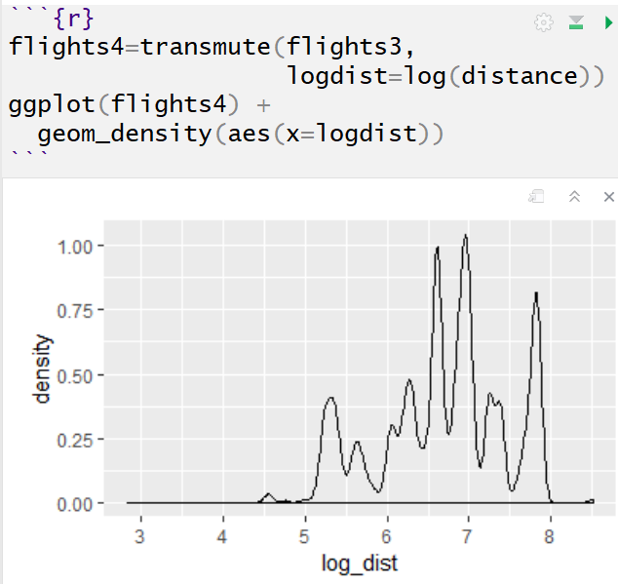
mutate()
Plethora of Examples
Nonlinear Transformation

Slide 28
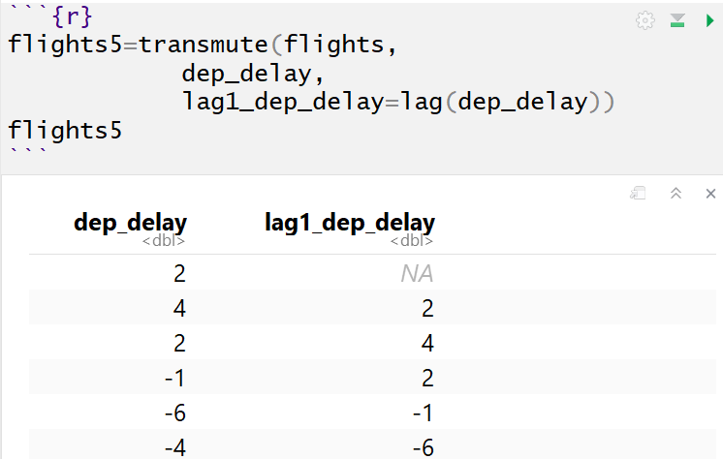
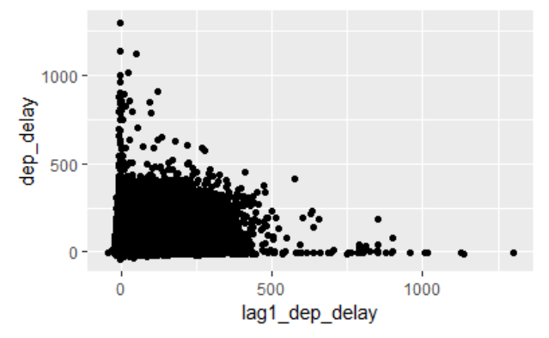
mutate()
Plethora of Examples
Offsets

Slide 29
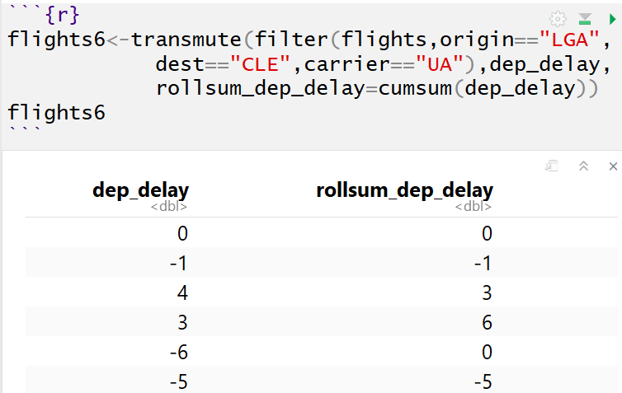
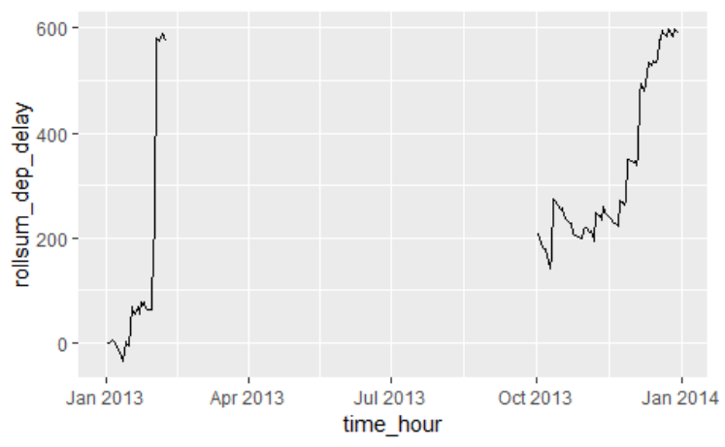
mutate()
Plethora of Examples
Cumulative and Rolling Aggregates

Slide 30
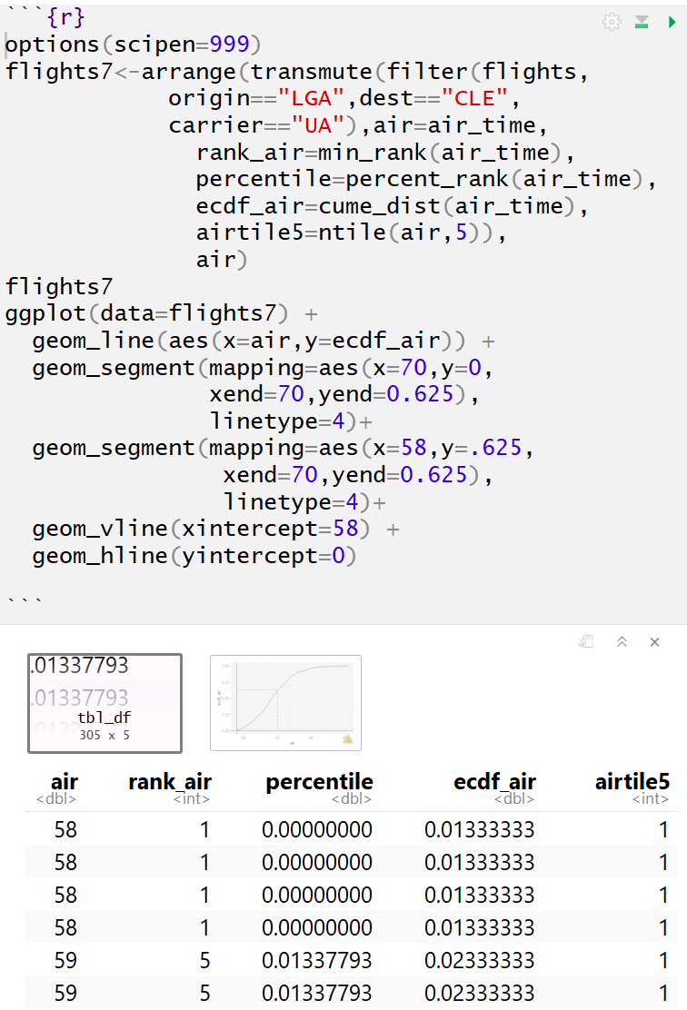
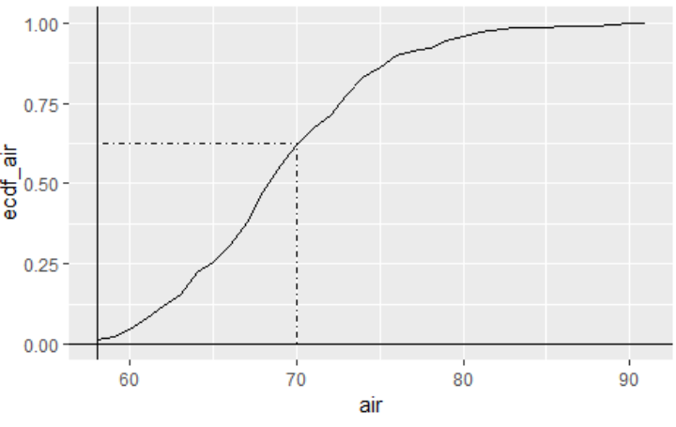
mutate()
Plethora of Examples
Ranking

Slide 31
Closing
Disperse and Make Reasonable Decisions

